Slide 1
CSCI 631 Foundations of Computer Vision
Ifeoma Nwogu
ion@cs.rit.edu

Slide 2
Schedule
Last class
Linear filters, convolution and template matching
Today
Edges and image pyramids

Slide 3
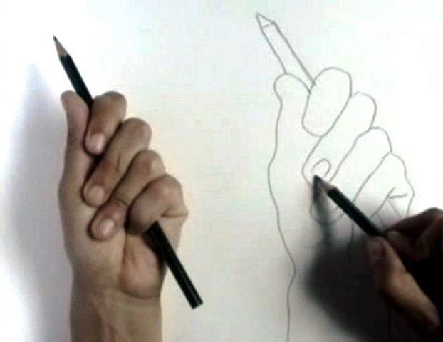
Edge detection
Goal: Identify sudden changes (discontinuities) in an image
Intuitively, semantic and shape information from the image can be encoded in the edges
More compact than pixels
Ideal: artist’s line drawing (but artist is also using object-level knowledge)

Slide 4
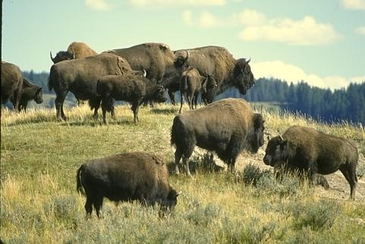
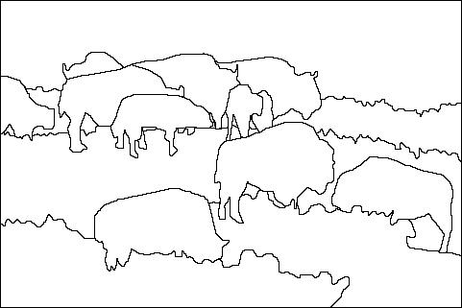
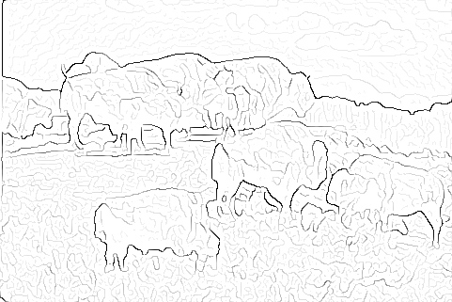

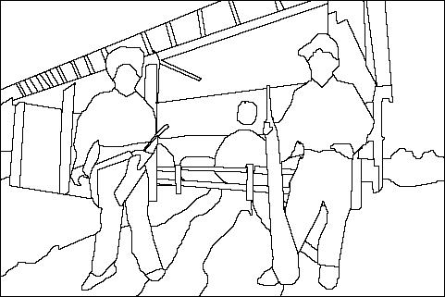
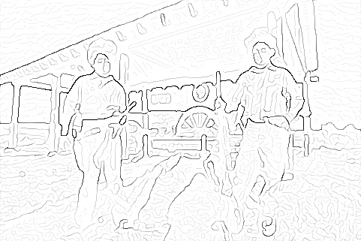
Human vs machine edges
image
human segmentation
gradient magnitude
Berkeley segmentation database: http://www.eecs.berkeley.edu/Research/Projects/CS/vision/grouping/segbench/

Slide 5
Intuitions guiding edge detection
Pixels tend strongly to be like their neighbors
This is the single most important experimental fact about images
Consequences
We can estimate a pixel value using its neighbors
***Pixels that are different from their neighbors are important***
Smoothing with a Gaussian
Works because pixels look like their neighbors
Suppresses noise because positive, negative errors tend to cancel

Slide 6
Intuitions guiding edge detection
Pixel could differ from neighbor because
they have different albedos
they are on different objects
they have different surface normals
there is a big difference in shading (e.g. an outdoor shadow)
Pixels that differ from their neighbors are interesting
they occur when the gradient is large
but image noise has large gradients, too
Key idea
suppress image noise by smoothing, then take gradients

Slide 7
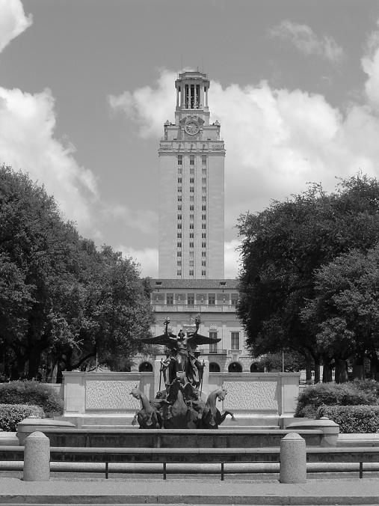
Contrast and invariance

Slide 8
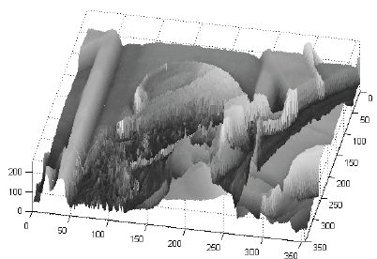

Recall : Images as functions
Edges look like steep cliffs
Source: S. Seitz

Slide 9

Derivatives and edges
An edge is a place of rapid change in the image intensity function.
intensity function (along horizontal scanline)
image
first derivative
edges correspond to extrema of derivative
Source: L. Lazebnik

Slide 10
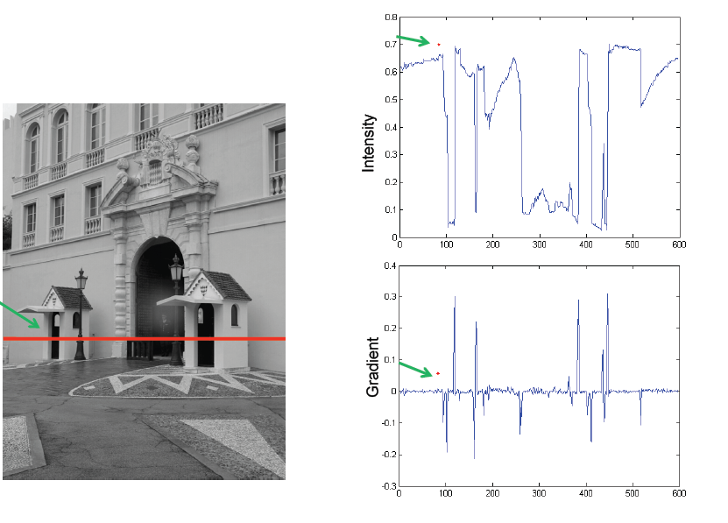
Derivatives and edges cont’d
Source: L. Fei Fei

Slide 11

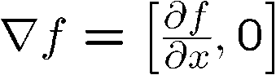
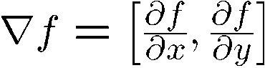
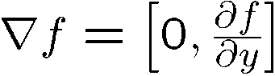
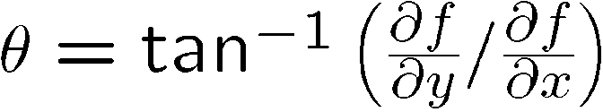
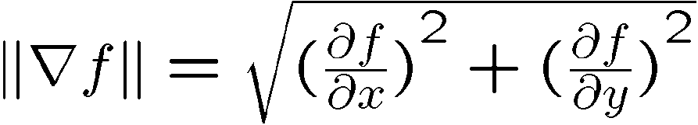
Image gradient
The gradient of an image:
The gradient points in the direction of most rapid increase in intensity
How does this direction relate to the direction of the edge?
The gradient direction is given by
The edge strength is given by the gradient magnitude
Source: Steve Seitz
Notes:
give definition of partial derivative: lim h->0 [f(x+h,y) – f(x,y)]/h

Slide 12
Differentiation and convolution
For 2D function, f(x,y), the partial derivative is:
For discrete data, we can approximate using finite differences:
This is linear and shift invariant (must be the result of a convolution)
To implement the above as convolution, what would be the associated filter?
-1 | 1

Slide 13
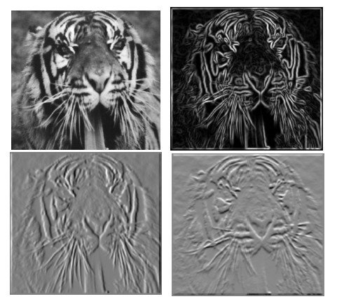
Partial derivatives of an image
?
-1 1
1 -1
-1 1
or
Which shows changes with respect to x?

Slide 14
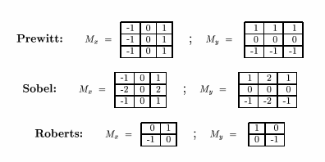
Finite difference filters
Other approximations of derivative filters exist:
Source: K. Grauman

Slide 15
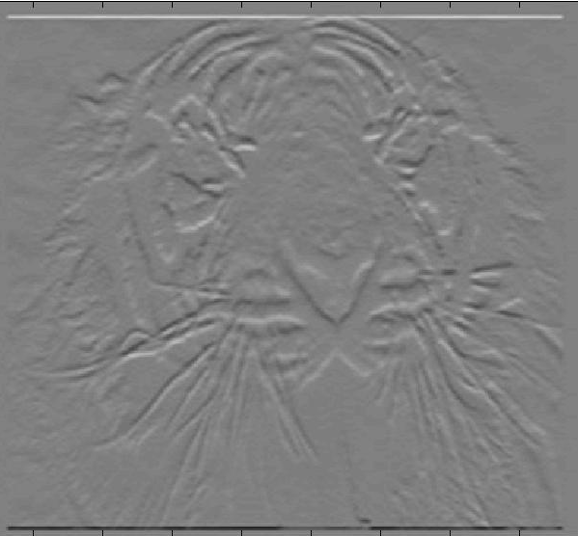
Finite difference filters cont’d
1 | 2 | 1
0 | 0 | 0
-1 | -2 | -1
Sobel_y =

Slide 16
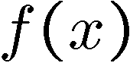
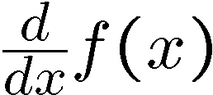
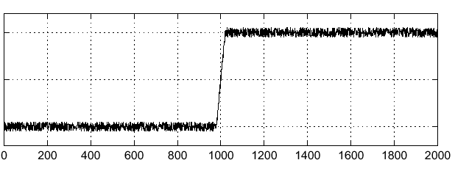
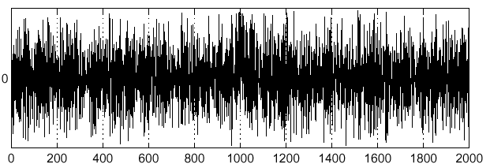
Noise
Consider a single row or column of the image
Plotting intensity as a function of position gives a signal
Where is the edge?

Slide 17


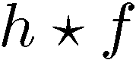
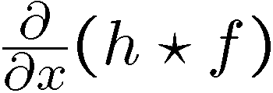
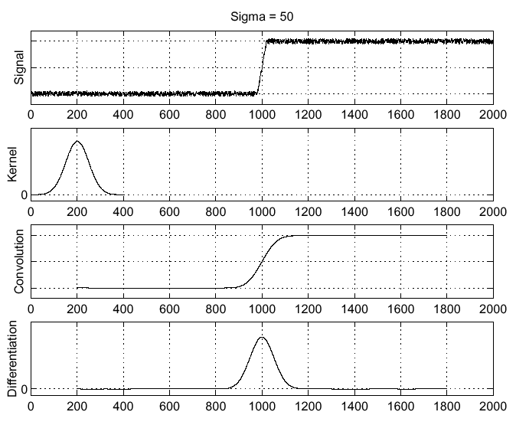
Solution: smooth first
Where is the edge?
Look for peaks in

Slide 18
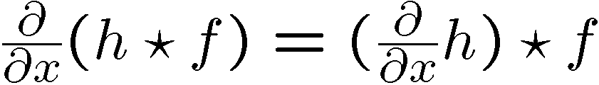
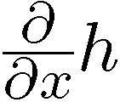
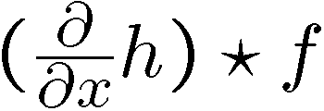
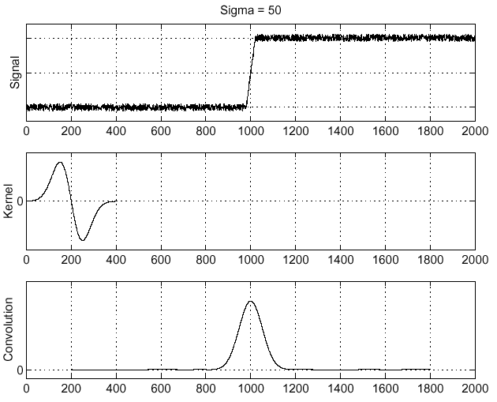
Derivative theorem of convolution
Differentiation property of convolution.
Compare with previous slide

Slide 19
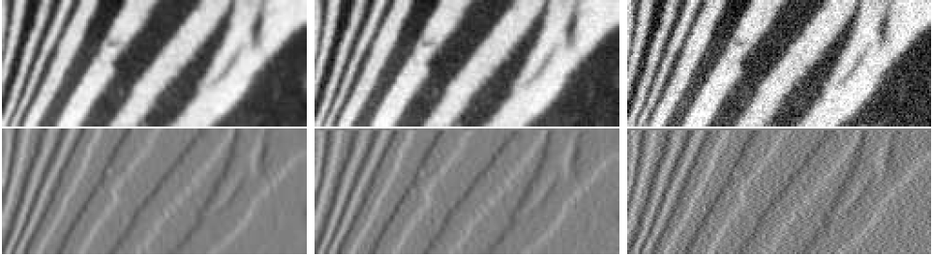
But derivatives amplify noise
Derivative estimates appear below images
notice grainy speckle in noisier, noisiest images
this is noise amplified by differentiation
derivative filters respond strongly to pixels that differ from their neighbors
Input image
Noisier Input image
Noisiest Input image

Slide 20
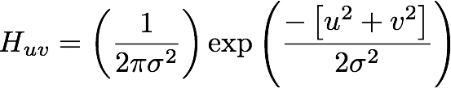
And smoothing reduces noise
Pixels tend to “be like” their neighbors
surfaces turn slowly
relatively few reflectance changes
Expect noise to be independent from pixel to pixel
Implies that smoothing suppresses noise, for appropriate noise models
Scale
the parameter in the symmetric Gaussian
as this parameter goes up, more pixels are involved in the average
and the image gets more blurred
and noise is more effectively suppressed
Scale

Slide 21
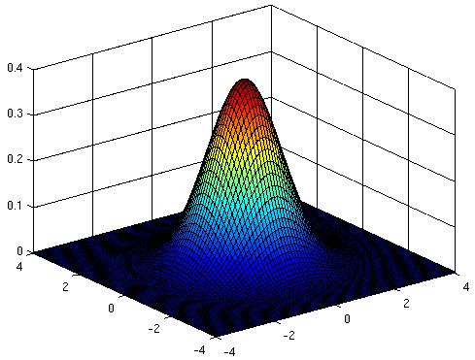
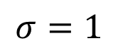
The Gaussian smoothing kernel
The symmetric Gaussian kernel in 2D; scaled so that its sum equal 1; Also,
Convolution with this kernel forms a weighted average where strongest response is at the center
Image point at the middle gets little contribution from points at the boundary
$$σ=1$$

Slide 22
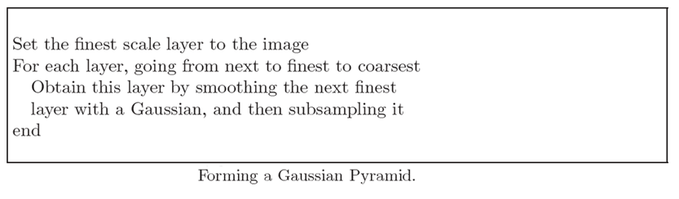
Gaussian pyramids and scale
A smoothed image can be resampled
result:
lower resolution version
emphasizing large scale trends over detail
and again, ...

Slide 23
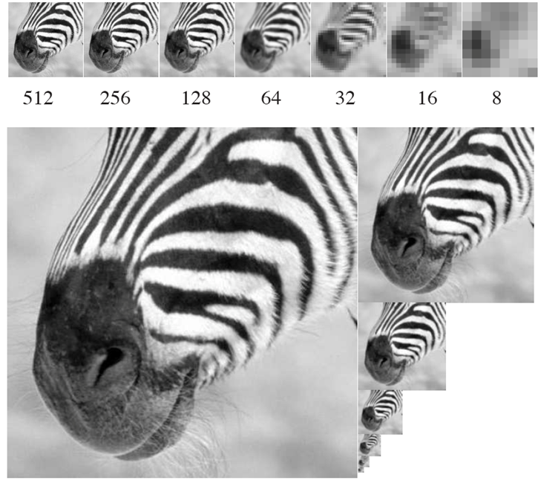

A Gaussian pyramid
-A Gaussian pyramid running from 512 x 512 to 8 x 8

Slide 24
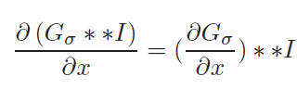
Back to smoothed gradients
Fact: These two are the same
Smooth, then differentiate -
Filter with derivative of Gaussian
Exploit:
Filter image with derivative of Gaussian filters to get smoothed gradient

Slide 25
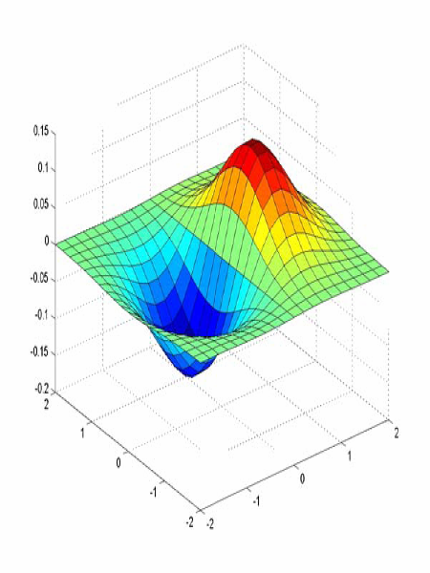
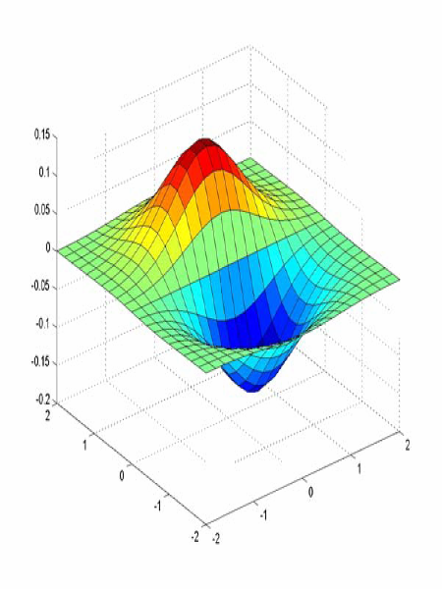
Derivative of Gaussian filters
x-direction
y-direction
Source: L. Lazebnik

Slide 26
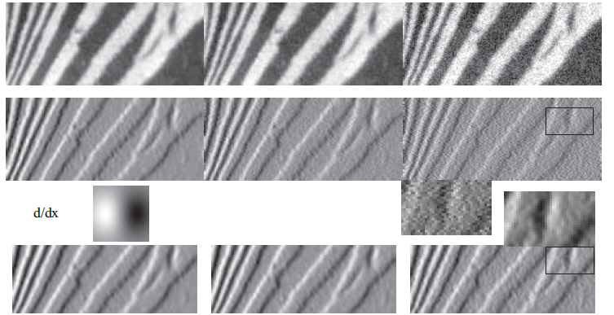
More Noise
Derivative
result
Derivative
of Gaussian
result
Figure 5.2

Slide 27
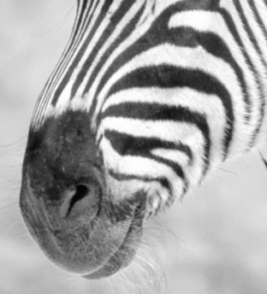
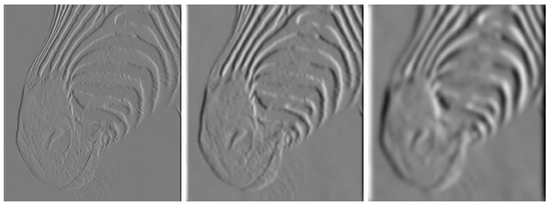
Scale of the Gaussian derivative filter
1 pixel
3 pixels
7 pixels
The scale of the Gaussian used in the DoG filter has significant effects on the results
Smoothed derivative removes noise, but blurs edge. Also finds edges at different “scales”
Small scale shows more details like hair while large scale loses some of the stripes at the muzzle

Slide 28
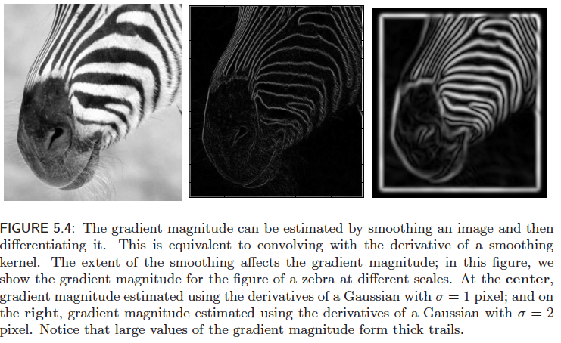
Implementation issues
The gradient magnitude is large along a thick “trail” or “ridge,” so how do we identify the actual edge points?
How do we link the edge points to form curves?

Slide 29
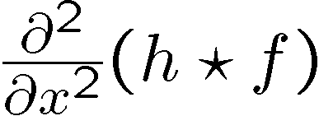
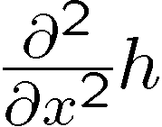
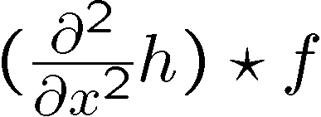
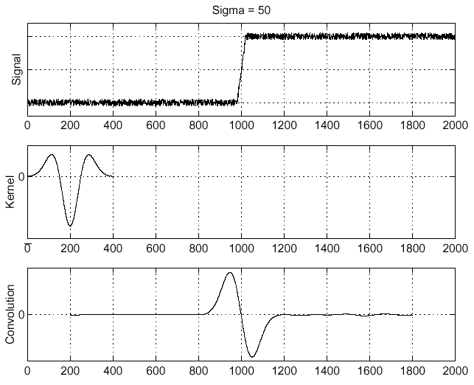
Laplacian of Gaussian
Consider
Laplacian of Gaussian
operator
Where is the edge?
Zero-crossings of bottom graph

Slide 30
Laplacian and Gaussian Pyramids
Image from Celestino et al., PLOS ONE 2018
Top row shows how to build a Gaussian pyramid
successively smoothing (blurring) and down-sampling the images. I2, I1 and I0 are elements of the Gaussian pyramid,
H2, H1 and I0 are the elements of the Laplacian pyramid.
H2 and H1 are high-pass sub-bands obtained by subtracting two adjacent images of the Gaussian pyramid.

Slide 31
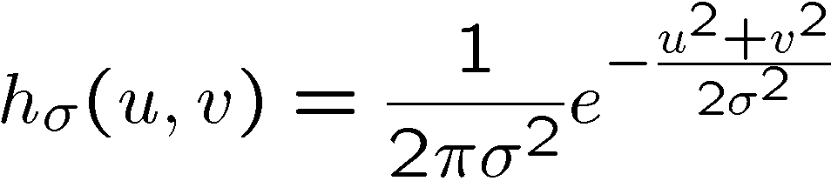
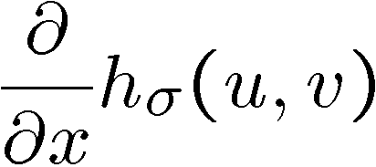
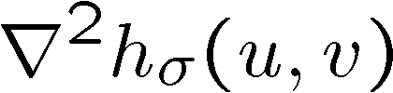
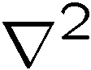
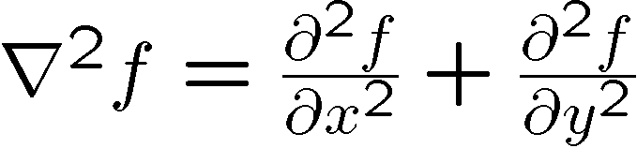



2D edge detection filters
Laplacian of Gaussian
Gaussian
derivative of Gaussian
is the Laplacian operator:
Notes:
31

Slide 32

Designing an edge detector
Criteria for an “optimal” edge detector:
Good detection: the optimal detector must have a small number of false positives (detecting spurious edges caused by noise), and a small number of false negatives (missing real edges)
Good localization: the edges detected must be as close as possible to the true edges
Single response: the detector must return one point only for each true edge point; that is, minimize the number of local maxima around the true edge

Slide 33
Canny edge detector
This is probably the most widely used edge detector in computer vision
Theoretical model: step-edges corrupted by additive Gaussian noise
Canny has shown that the first derivative of the Gaussian closely approximates the operator that optimizes the product of signal-to-noise ratio and localization
skimage.feature.canny(image, sigma=3)
See Jupyter notebook
J. Canny, A Computational Approach To Edge Detection, IEEE Trans. Pattern Analysis and Machine Intelligence, 8:679-714, 1986.
Source: L. Fei-Fei

Slide 34
Canny edge detector
Filter image with derivative of Gaussian
Find magnitude and orientation of gradient
Non-maximum suppression
Thin multi-pixel wide “ridges” down to single pixel width
Double Thresholding
Deﬁne two thresholds: low and high
Use the high threshold to start edge curves and the low threshold to continue them
Hysteresis linking
Source: D. Lowe, L. Fei-Fei

Slide 35
Example
Original image (Lena)

Slide 36
Canny edge detector
Filter image with derivative of Gaussian
Find magnitude and orientation of gradient
Non-maximum suppression
Thin multi-pixel wide “ridges” down to single pixel width
Double Thresholding
Deﬁne two thresholds: low and high
Use the high threshold to start edge curves and the low threshold to continue them
Hysteresis linking
Source: D. Lowe, L. Fei-Fei

Slide 37

Derivative of Gaussian (DoG) filter

Slide 38


DoG filter responses
x-derivative
of Gaussian
filter response
y-derivative
of Gaussian
filter response

Slide 39
Canny edge detector
Filter image with derivative of Gaussian
Find magnitude and orientation of gradient
Non-maximum suppression
Thin multi-pixel wide “ridges” down to single pixel width
Double Thresholding
Deﬁne two thresholds: low and high
Use the high threshold to start edge curves and the low threshold to continue them
Hysteresis linking
Source: D. Lowe, L. Fei-Fei

Slide 40



Gradient-based values
x-derivative
of Gaussian
filter response
y-derivative
of Gaussian
filter response
Gradient
magnitude
Orientation at each pixel
$$θ=\tan^{−1}{\frac{gy}{gx}}$$

Slide 41
Canny edge detector
Filter image with derivative of Gaussian
Find magnitude and orientation of gradient
Non-maximum suppression
Thin multi-pixel wide “ridges” down to single pixel width
Double Thresholding
Deﬁne two thresholds: low and high
Use the high threshold to start edge curves and the low threshold to continue them
Hysteresis linking

Slide 42

Non-maximum Suppression
Create a new matrix of zeros
Visit every pixel in the original gradient matrix
Draw a line in the direction of the gradient at that pixel
Check the value of the neighboring pixels along the gradient line
Enter the intensity at the location of the pixel with max intensity in the matrix of zeros
As the name states, you want to suppress all non-maximum values

Slide 43


Non-maximum suppression cont’d
Before non-max suppression
After non-max suppression

Slide 44
Canny edge detector
Filter image with derivative of Gaussian
Find magnitude and orientation of gradient
Non-maximum suppression
Thin multi-pixel wide “ridges” down to single pixel width
Double Thresholding
Deﬁne two thresholds: low and high
Hysteresis linking
Source: D. Lowe, L. Fei-Fei

Slide 45

Double thresholding
Identify 3 kinds of pixels: strong, weak, and non-relevant
Use the high threshold to identify strong pixels
Use the low threshold to identify non-relevant pixels
All pixels having intensity between both thresholds are flagged as weak

Slide 46
Canny edge detector
Filter image with derivative of Gaussian
Find magnitude and orientation of gradient
Non-maximum suppression
Thin multi-pixel wide “ridges” down to single pixel width
Double Thresholding
Deﬁne two thresholds: low and high
Hysteresis linking
Source: D. Lowe, L. Fei-Fei

Slide 47
Hysteresis linking
Using the thresholding results, either connect weak pixels to strong or drop them
Use strong pixels to start edge curves and a weak pixels to continue them
Reduces drop-outs
Retain weak pixels only if there is a strong one in the neighborhood
Neighborhood ideally should be defined only in the direction of the edge (tangential to the gradient)
Pixel updates for linking happen on the same image

Slide 48

Hysteresis linking
Hysteresis implies that what happens now relies on what happened in the past steps

Slide 49

Hysteresis thresholding

Slide 50
Canny edge detector
Filter image with derivative of Gaussian
Find magnitude and orientation of gradient
Non-maximum suppression
Thin multi-pixel wide “ridges” down to single pixel width
Double Thresholding
Deﬁne two thresholds: low and high
Hysteresis linking
Source: D. Lowe, L. Fei-Fei

Slide 51

Final Canny edges

Slide 52





Effect of σ (Gaussian kernel spread/size)
original
Canny with
$$σ=1$$
Canny with
$$σ=2$$
The choice of σ depends on desired behavior
small σ detects fine features
large σ detects large scale edges
Source: S. Seitz

Slide 53
Summary
We started with linear filters
including filter construction and separability, convolution methods and image blurring
In this class we discussed filter derivatives and scale space/pyramids
including 1st and 2nd derivatives of the Gaussian filters, the Gaussian pyramid and the Laplacian pyramid
We also discussed how DoG filters detect edges and how post-processing works
specifically we focused on the Canny edge detector and its post-processing techniques

Slide 54
Slide Credits
David A. Forsyth - UIUC
Fei Fei Li - Stanford
Svetlana Lazebnik – UIUC
Rob Fergus – NYU

Slide 55

Questions

